Slide 1


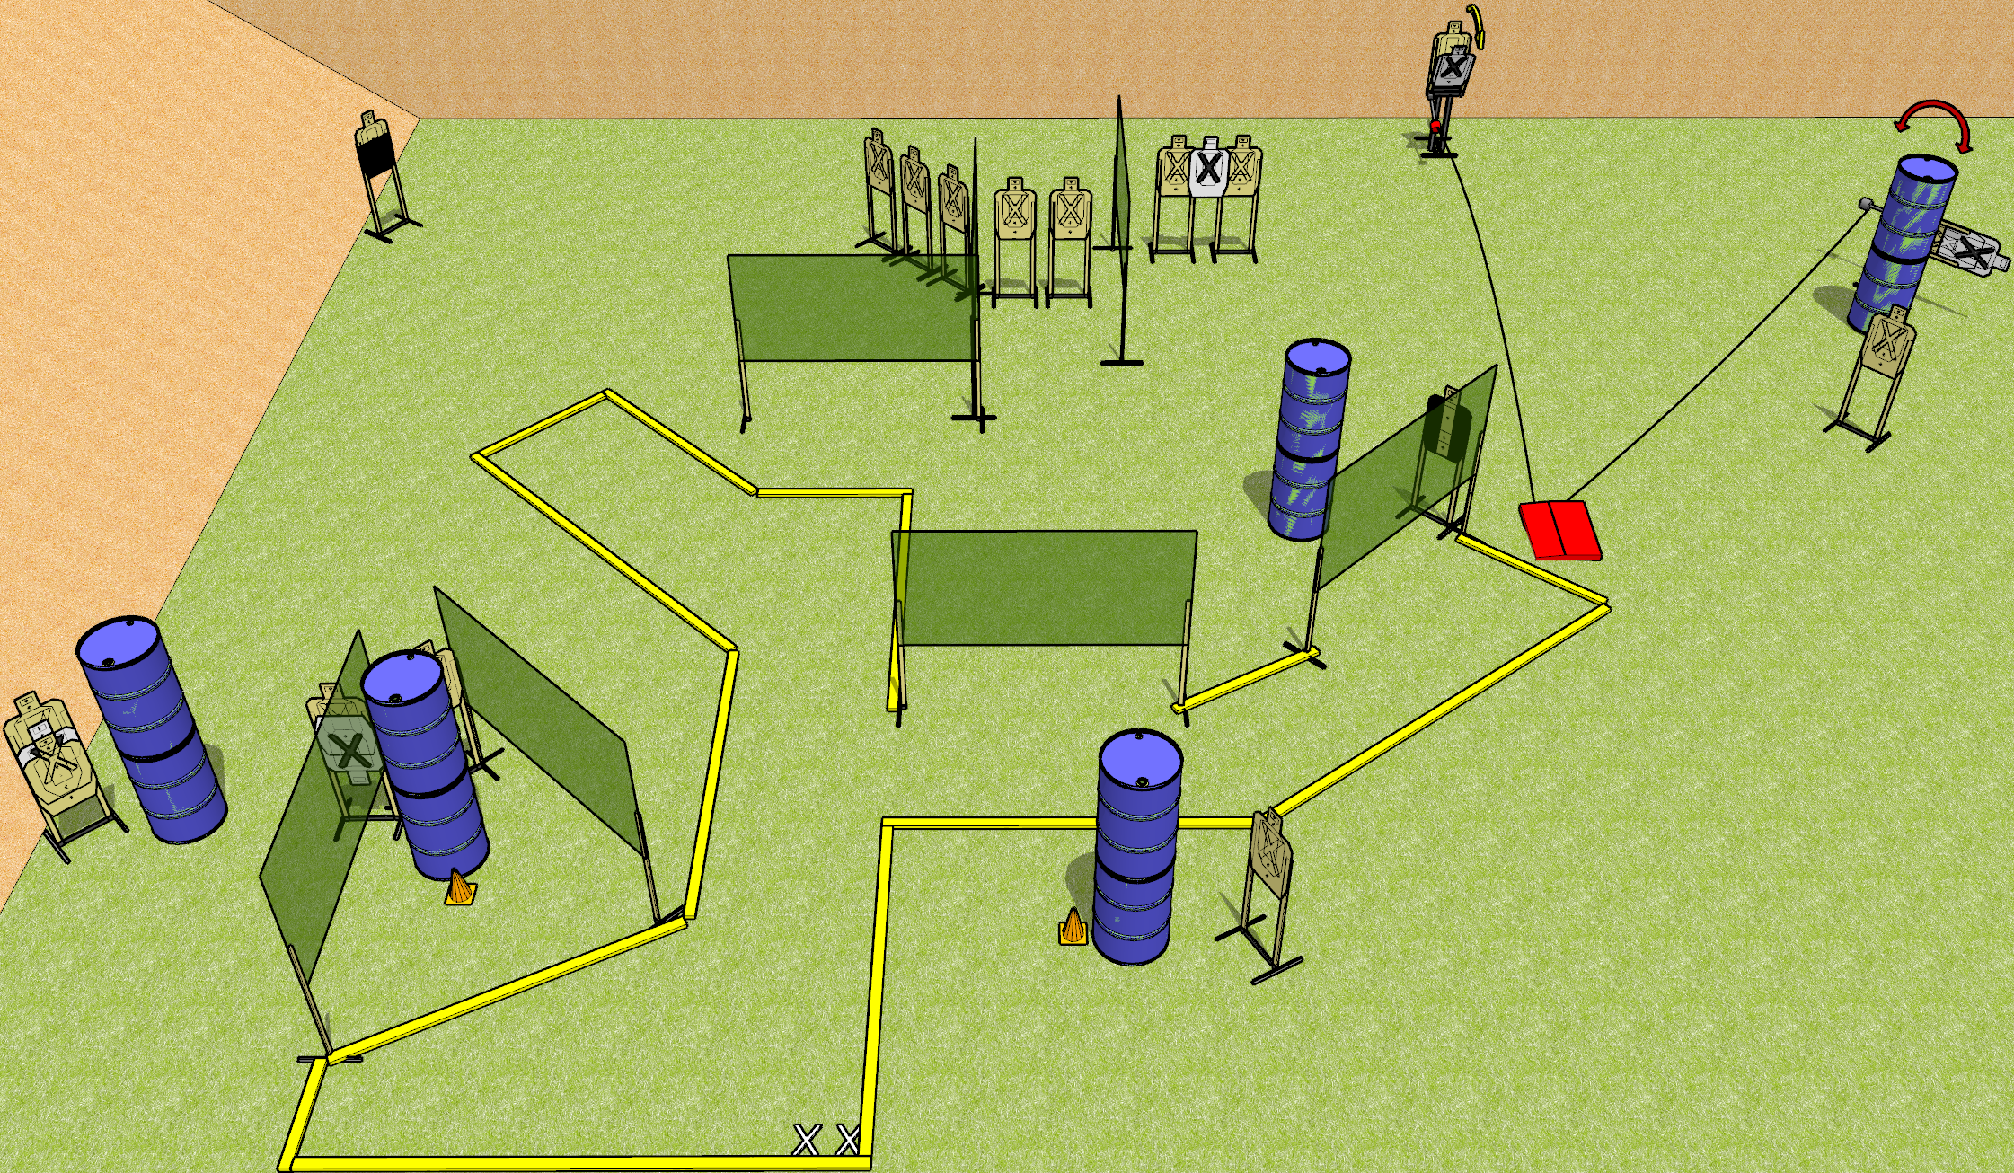
 | Dothan Gun Club – USPSA Match Three Piece Course Designer : Drew Coleman
START POSITION : Standing with both feet on X’s, wrists below belt
GUN READY CONDITION : Pistol loaded and holstered. PCC loaded, shouldered, safety on, pointed at either orange cone. |  | SCORING: Comstock, 34 rounds TARGETS: 17 paper, 0 Steel SCORED HITS: Best 2 on paper, steel until down START-STOP: Audible, last shot RULES: both moving targets must be activated before being engaged, and neither are disappearing targets.
STAGE PROCEDURE: Engage targets as they become available from within the fault lines.

Slide 2
Three Piece
Written Stage Briefing
Three Piece is a 34 round, 170 point, Comstock field course. There are seventeen USPSA targets. The best two hits on paper will score. The start signal is audible.
Handgun start position is standing with both feet on X’s, wrists below belt. Handgun is loaded and holstered.
PCC start position is standing with both feet on X’s, muzzle aimed at either orange cone. Loaded carbine is held with both hands, safety on, shouldered.
Upon start signal, engage the targets as they become available. The stomp pad will activated the max trap and the swinger. Both targets are available at rest, and must be activated before being engaged.

